Slide 1
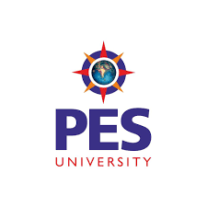
UE19CS204 – Web Technologies Mini Project
Project Title –Social Media Application
Section -D
Team Member Names – Team member SRNs
1.Kumar Kiran A N - PES1UG19CS236
2.Kirankumar K R - PES1UG19CS219
3.K Sai Tharun Reddy-PES1UG19CS228
4.Kushal T M - PES1UG19CS240
GITHUB Link -https://github.com/kirankumarkr5901/Social-media-application-using-MERN

Slide 2
Abstract
MERN is considered as a fancy kid in town with full-stack JavaScript. It is a combination of technologies MongoDB, Express, React and Node, used to build premium web applications. These are developed using multiple technologies including frameworks, databases, libraries and more. MERN stack is a JavaScript stack used for the effortless flow of the development process.
The technology stack used for the project in this study consists of MongoDB for the data storage layer, Node and Express for the service layer with Json Web Token for API authentication, React for the frontend client .

Slide 3
Technologies Used
MongoDB :MongoDB is a document-oriented database which stores data in JSON-like documents with dynamic schema.
Express : Express provides server-side logic for web and mobile applications.
React :React JS is a JavaScript library used in web development to build interactive elements on websites.
Node :Node. js is primarily used for non-blocking, event-driven servers, due to its single-threaded nature. It's used for traditional web sites and back-end API services.
Material UI :For importing necessary templates.
Additional mdules:Jsonwebtoken, React-router, Nodemon, File loader,mongoose.

Slide 4
Member Contributions
(Functionality worked on by each team member)
Front-end (Kumar Kiran & Tharun Reddy)
Back-end(Kirankumar & Kushal )

